Slide 1

TASK2: PREDICTING CUSTOMER BUYING BEHAVIOUR
By: AMEEN MAGOBON ABDULFATAI
10/2/2023

Slide 2
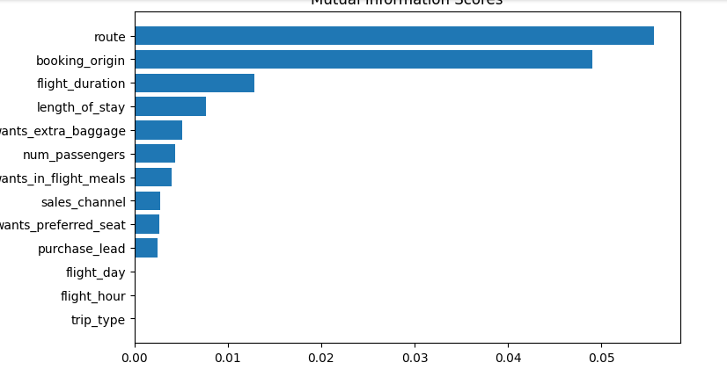
A RandomForrest Classifier Model was built:
Accuracy - 83.36%
AUC Score - 0.56

Slide 3
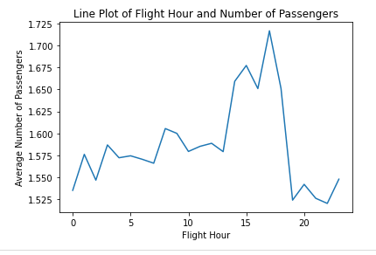
The top 3 features which influence customer buying behaviour are:
Route
Booking origin
Flight Duration

